Slide 1

Views, constraints and triggers
Database Management System | SQL and Advanced Query Formulation
Course: Database Management System | Chapter: SQL and Advanced Query Formulation | Program: Bachelor of Engineering
DISCOVER · LEARN · EMPOWER
Notes:
Welcome everyone to today's session on Views, Constraints, and Triggers. These are critical tools for maintaining data integrity and simplifying complex queries in our DBMS. We will explore how these features transform raw data into secure, reliable information systems. Let us begin by understanding how they fit into our broader course outcomes.

Slide 2
Course Outcomes
SLIDE 2 / 14
Course Outcome
CO | BT LEVEL | DESCRIPTION
CO1 | BT2 | Explain database architecture, relational model concepts and formal query language foundations including relational algebra and relational calculus.
CO2 | BT3 | Apply relational algebra, relational calculus and SQL constructs to formulate correct and efficient database queries.
CO3 | BT4 | Analyze functional dependencies and design normalized relational schemas up to 5NF ensuring lossless join and dependency preservation.
CO4 | BT4 | Analyze transaction schedules and concurrency control mechanisms to determine serializability, recoverability and correctness.
CO5 | BT5 | Evaluate storage structures, indexing strategies and query optimization techniques for performance, scalability and reliability.
Chandigarh University
2 / 14
Notes:
Today's lecture directly addresses CO2 by teaching you how to write efficient queries using views. It also supports CO3 by ensuring your normalized schemas remain valid through the use of constraints and triggers. These outcomes ensure you can build robust database applications that are both efficient and reliable.

Slide 3
Learning Objectives
SLIDE 3 / 14
Learning Outcomes
1
Define views as virtual tables derived from base tables without storing data physically.
2
Analyze the role of constraints in enforcing data integrity and business rules automatically.
3
Evaluate triggers as stored procedures that execute automatically in response to database events.
4
Apply SQL syntax to create complex views that simplify user access to sensitive data.
5
Design trigger mechanisms to prevent invalid updates and maintain referential integrity consistently.
Chandigarh University
3 / 14
Notes:
By the end of this session, you will be able to define views as virtual tables that do not store data physically. You will analyze how constraints enforce business rules automatically without manual intervention. We will also evaluate triggers as stored procedures that execute automatically when specific database events occur. Finally, you will apply these concepts to design secure and robust database systems.

Slide 4
Lecture
SLIDE 4 / 14
Concept of Database Views
1
A view is a virtual table based on the result-set of an SQL statement.
2
Views do not store data physically but reference the underlying base tables dynamically.
3
They provide a simplified interface for users to access complex query results easily.
4
Views can restrict access to specific columns, enhancing security for sensitive data.
5
Updating a view depends on the complexity of the underlying query definition.
6
Materialized views store the result physically for performance but require refresh.
Chandigarh University
4 / 14
Notes:
Think of a view as a saved query that acts like a table. When you query a view, the database engine executes the underlying SQL statement on the fly. This means the data is not stored twice, saving space but potentially impacting performance on complex views. For example, a view named 'StudentDetails' might hide the 'Password' column from the 'Students' table.

Slide 5
Lecture
SLIDE 5 / 14
SQL Syntax for Creating Views
SYNTAX
CREATE VIEW view_name AS SELECT columns FROM table WHERE condition.
• Use CREATE VIEW command followed by the view name and column list.
• The AS keyword introduces the SELECT statement that defines the view logic.
• Views can be created from single tables or multiple joined tables seamlessly.
• The WITH CHECK OPTION ensures updates to the view satisfy the view's WHERE clause.
• Dropping a view uses the DROP VIEW command to remove the definition.
Chandigarh University
5 / 14
Notes:
The syntax is straightforward: you define the view name and then specify the SELECT query. For instance, 'CREATE VIEW ActiveStudents AS SELECT × FROM Students WHERE Status = Active'. The WITH CHECK OPTION is crucial because it prevents users from inserting data into the view that would not appear in the view itself. This maintains logical consistency between the view and the base table.

Slide 6
Lecture
SLIDE 6 / 14
Types of Database Constraints
1
NOT NULL ensures a column cannot contain empty or null values at all ×.
2
UNIQUE guarantees that all values in a column are distinct across the table.
3
PRIMARY KEY combines NOT NULL and UNIQUE to uniquely identify each row.
4
FOREIGN KEY enforces referential integrity by linking to a primary key in another table.
5
CHECK enforces domain integrity by limiting the values that can be entered.
6
DEFAULT provides a value if none is specified during an insert operation.
Chandigarh University
6 / 14
Notes:
Constraints are the rules that keep your data clean and consistent. A NOT NULL constraint prevents missing critical information, while UNIQUE ensures no duplicates exist. The PRIMARY KEY is the most important as it uniquely identifies every record. For example, a CHECK constraint can ensure that 'Age' is always greater than zero.

Slide 7
Lecture
SLIDE 7 / 14
Referential Integrity and Foreign Keys
1
Foreign keys link a column in one table to the primary key of another.
2
They prevent actions that would destroy the link between related table records.
3
Cascading updates automatically change the foreign key value when the primary key changes.
4
Cascading deletes automatically remove child records when the parent record is deleted.
5
Without foreign keys, orphaned records can exist, breaking data relationships permanently.
6
The ON DELETE CASCADE clause is used to automate deletion of dependent rows.
Chandigarh University
7 / 14
Notes:
Referential integrity ensures that relationships between tables remain valid. If you delete a student, you must decide what happens to their grades. A foreign key with ON DELETE CASCADE will automatically remove the grades. Without this, you would have orphaned grade records that no longer belong to any student. This is vital for maintaining a clean database state.

Slide 8
Worked Example
SLIDE 8 / 14
Constraint Implementation
EXAMPLE SQL
ALTER TABLE Orders ADD CONSTRAINT FK_Customer FOREIGN KEY (CustID) REFERENCES Customers(CustID).
• Table 'Employees' has a CHECK constraint: Salary must be greater than 10000.
• Inserting a salary of 5000 will fail and return an error message immediately.
• Table 'Orders' has a FOREIGN KEY linking to 'Customers' CustomerID.
• Inserting an order for a non-existent CustomerID will be rejected by the DBMS.
• This prevents invalid data entry and ensures business rules are strictly followed.
Chandigarh University
8 / 14
Notes:
Let's look at a concrete example. If we try to insert an employee with a salary of 5000, the CHECK constraint will block it. Similarly, if we try to place an order for a customer ID that does not exist, the foreign key constraint will reject it. This automatic validation saves developers from writing manual error-checking code in their applications. It ensures data quality at the database level.

Slide 9
Lecture
SLIDE 9 / 14
Concept of Database Triggers
1
A trigger is a stored procedure that automatically executes when a specific event occurs.
2
Events include INSERT, UPDATE, or DELETE operations on a specific table.
3
Triggers fire either BEFORE the event to validate data or AFTER to log changes.
4
They are used to enforce complex business rules that constraints cannot handle alone.
5
Triggers can modify data in other tables or prevent the triggering action entirely.
6
They provide an audit trail by logging who changed data and when.
Chandigarh University
9 / 14
Notes:
Triggers are like automated guards that watch your tables. When you insert, update, or delete data, the trigger fires automatically. For example, a trigger can log every salary change to an audit table. This is useful for compliance and security. Unlike constraints, triggers can perform complex logic involving multiple tables.

Slide 10
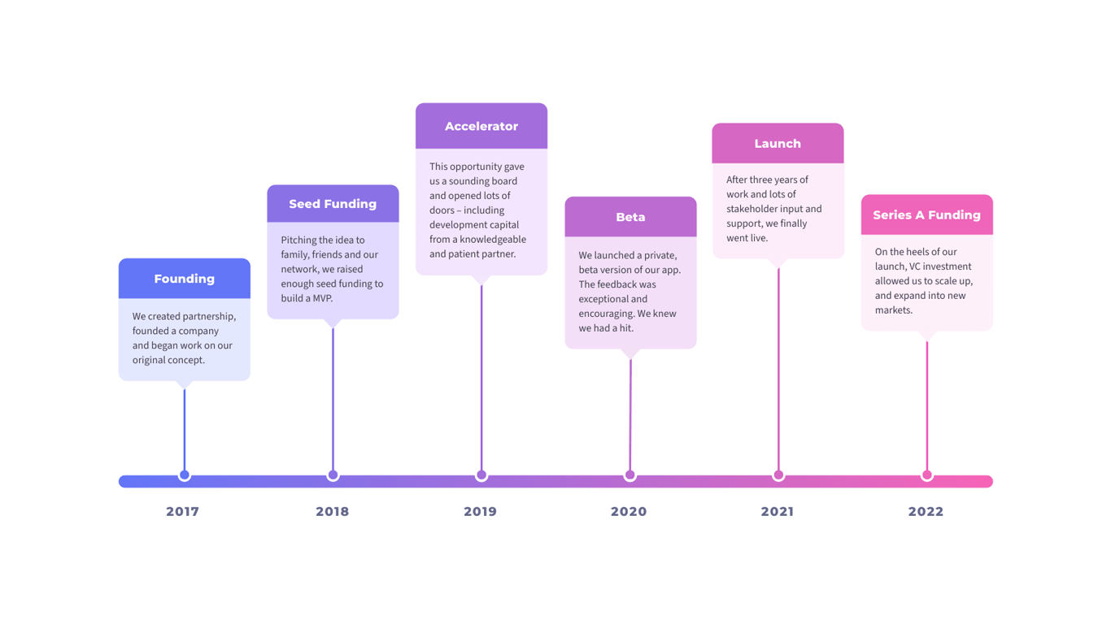
Lecture
SLIDE 10 / 14
Trigger Timing and Execution Logic
1
BEFORE triggers execute before the data modification and can modify the incoming data.
2
AFTER triggers execute after the modification and are used for logging or notifications.
3
Row-level triggers fire once for each row affected by the statement.
4
Statement-level triggers fire once for the entire SQL statement regardless of rows.
5
The NEW keyword refers to the new value in an INSERT or UPDATE.
6
The OLD keyword refers to the old value in an UPDATE or DELETE.
Source: landing.moqups.com
Chandigarh University
10 / 14
Notes:
You can choose when your trigger fires. A BEFORE trigger can change the data before it is saved, perhaps converting text to uppercase. An AFTER trigger is better for logging because the data is already in the table. The NEW and OLD keywords allow you to access the data being changed. This flexibility makes triggers powerful tools for maintaining data integrity.

Slide 11
Worked Example
SLIDE 11 / 14
Trigger for Audit
LOGIC
INSERT INTO SalaryAudit VALUES (OLD.Salary, NEW.Salary, CURRENT_TIMESTAMP).
• Create a trigger 'AuditSalary' on the 'Employees' table for UPDATE events.
• The trigger fires AFTER an update to the Salary column specifically.
• It inserts a record into 'SalaryAudit' table with the old and new values.
• This ensures every salary change is recorded for future auditing and analysis.
• The trigger prevents the update if the salary increase exceeds 20% without approval.
Chandigarh University
11 / 14
Notes:
Consider a scenario where we need to track salary changes. We create a trigger that fires after an update. It captures the old salary, the new salary, and the timestamp. This creates an automatic audit trail. Furthermore, we can add logic to block any increase greater than 20% unless a manager approves it. This enforces policy automatically.

Slide 12
Lecture
SLIDE 12 / 14
Common Pitfalls and Best Practices
1
Avoid recursive triggers that cause infinite loops by triggering themselves repeatedly.
2
Complex triggers can significantly degrade database performance during high-load operations.
3
Triggers are invisible to users and can lead to confusion if not documented well.
4
Overusing views can make debugging difficult as the query logic is hidden.
5
Always test triggers thoroughly to ensure they do not block legitimate updates.
6
Document all triggers and views clearly to maintain system transparency and clarity.
Chandigarh University
12 / 14
Notes:
There are common pitfalls you must avoid. Recursive triggers can cause infinite loops, crashing your system. Triggers can also slow down your database if they are too complex. Users might not know that a trigger is blocking their update, leading to confusion. Always document your triggers and views so that future developers understand the system logic.

Slide 13
Lecture
SLIDE 13 / 14
Key Takeaways
1
Views provide a secure, virtual layer over base tables without storing data.
2
Constraints enforce data integrity rules like NOT NULL, UNIQUE, and FOREIGN KEY.
3
Triggers automate complex business logic and auditing in response to data changes.
4
Proper use of these features ensures a robust and reliable database system.
5
Always balance performance needs with the complexity of views and triggers.
Chandigarh University
13 / 14
Notes:
To summarize, views simplify access and enhance security by hiding complex logic. Constraints are essential for maintaining data quality and relationships. Triggers allow for automated enforcement of business rules and auditing. Together, these features form the backbone of a reliable database management system. Remember to use them wisely to avoid performance issues.

Slide 14
Lecture
SLIDE 14 / 14
References
1
Fundamentals of Database Systems — Ramez Elmasri & Shamkant B. Navathe
2
Database System Concepts — Silberschatz, Korth & Sudarshan
3
Database Management Systems — Raghu Ramakrishnan & Johannes Gehrke
4
Oracle/MySQL Documentation — Oracle
Chandigarh University
14 / 14
Notes:
For further reading, I recommend the textbooks by Elmasri and Navathe, as well as Silberschatz. These books provide deep insights into database theory and implementation. The Oracle and MySQL documentation are also excellent resources for practical syntax and examples. Please review these materials to reinforce today's lecture.

